Slide 1

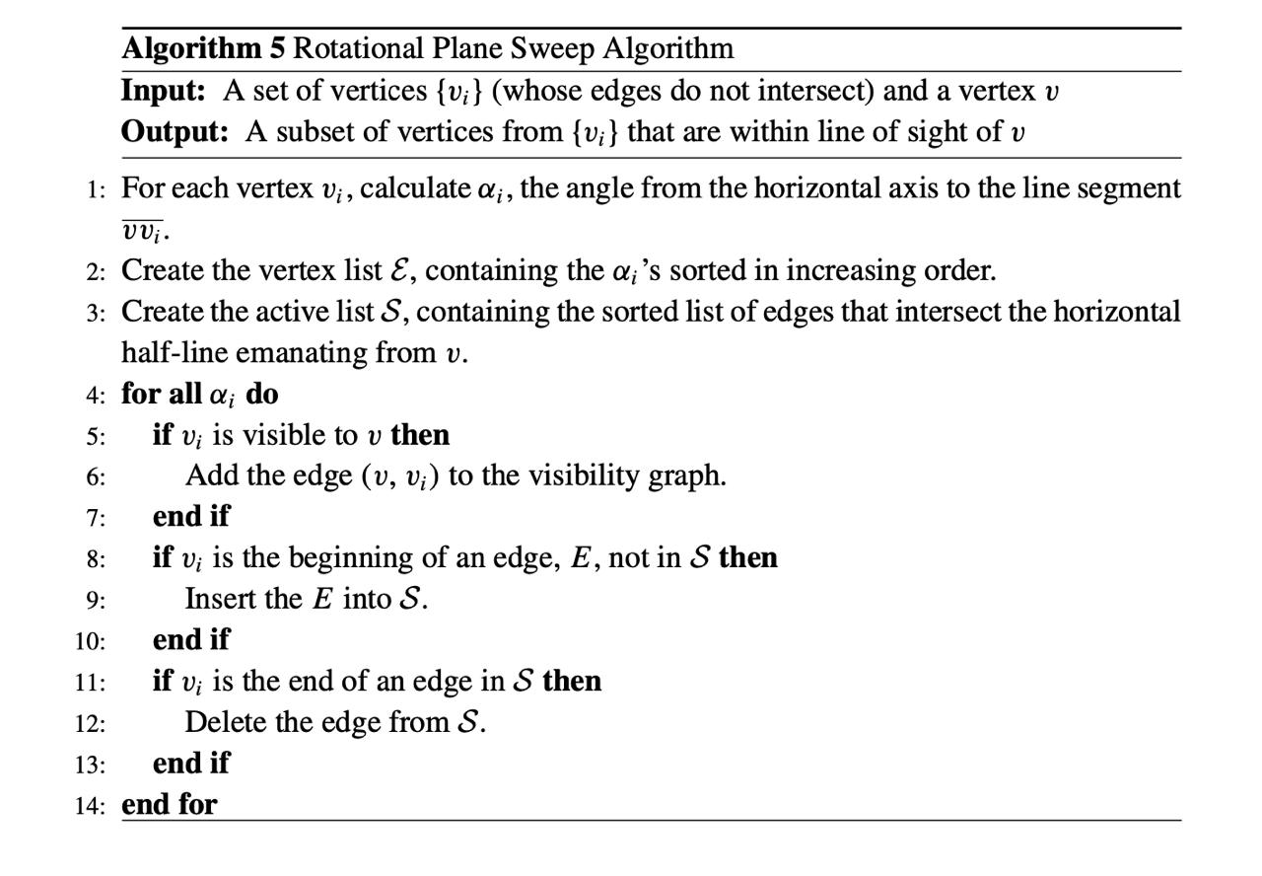
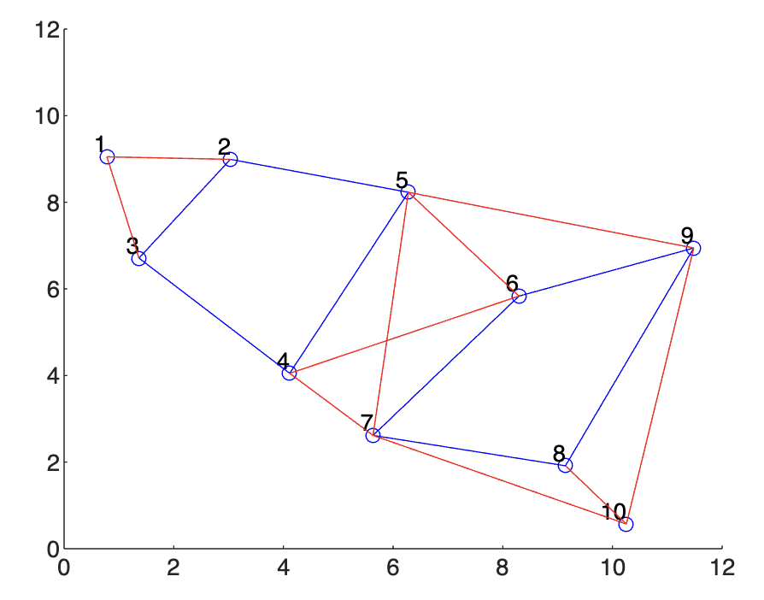
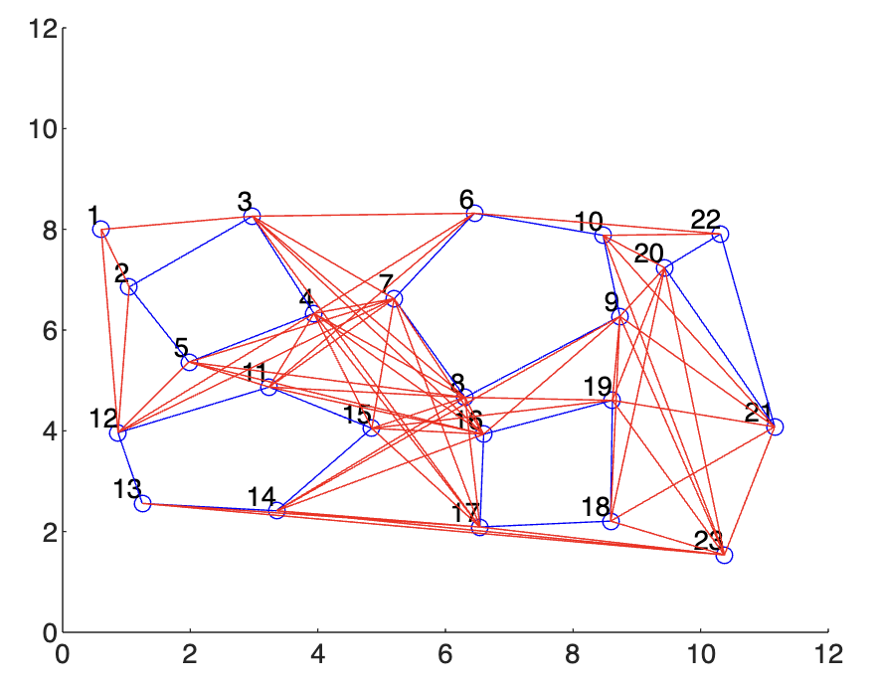
Rotational Plane Sweep Algorithm for Path Planning
Siri Arelli|| Harshit Kumar Chaubey || Karan Agrawal || Rapolu Shiva Teja
International Institute of Information Technology , Naya Raipur
INTRODUCTION
METHODOLOGY
CONCLUSIONS
The Rotational Plane Sweep algorithm is a key computational geometry technique used primarily in robot motion planning to create visibility graphs. These graphs are instrumental in navigating environments with obstacles, where determining clear paths is essential for efficient movement. By defining visibility between points, this algorithm helps in plotting feasible routes that robots can follow without collisions.
A visibility graph in the context of the Rotational Plane Sweep algorithm is a network of nodes and edges. Each node represents a significant point, typically corners of obstacles, while the edges connect nodes that are visible to each other without any intervening obstructions. The graph is constructed by 'sweeping' a line around each node and checking direct lines of sight to other nodes. If two points see each other directly without any obstacle interrupting, they are connected by an edge in the graph.
The practical application of this algorithm extends beyond simple navigation tasks. In robotics, it aids in path planning by simplifying complex environments into manageable graphs. Robots use these graphs to compute the shortest and most efficient routes from one point to another, taking into account various obstacles. This capability is vital in areas like warehouse management, autonomous vehicle routing, and even in strategic games and simulations where dynamic pathfinding is required.
Thus, the Rotational Plane Sweep algorithm not only supports basic movement tasks but also enhances the strategic decision-making capabilities of autonomous systems, making it a fundamental tool in the field of robotics and automated system navigation.
The Rotational Plane Sweep algorithm effectively creates visibility graphs for robotic path planning in obstacle-dense environments. It calculates clear paths by establishing visible connections between critical points, optimizing navigation and strategic movement in complex spaces.
Advantages :
Efficiently identifies visible paths between points, crucial for robotic navigation.
Construction of the visibility graph with n nodes using brute force has complexity n³ for all nodes while the rotational plane sweep algorithm takes only n²logn.
Disadvantages:
Can become computationally intensive in higher dimensions.
Requires precise measurement and accurate positioning of vertices.
May not handle dynamic environments where obstacles frequently move.
Dependent on clear line-of-sight, which might not be possible in all scenarios.
Tries to stay as close as possible to obstacles where any execution error will lead to a collision
RESULTS
Procudedure -
Calculate Angles and Initialize List: Measure angles between the current vertex and others, sort them, and initialize the list S with line segments that intersect a zero-angle sweeping line.
Check Intersections: Select the line segment closest to the current vertex from list S and check for intersections with other potential visibility lines. If no intersection, add the line to the visibility graph.
Update List S: After each intersection check, update list S by adding new edges that start and removing those that end.
Calculate Distances Properly: Compute the distance from the current vertex to the midpoint of each line segment to ensure accurate distance measurement for sorting in list S.
From the figures 1 and 2, you can see that the algorithm is working in both graphs. This work is very helpful to understand the theoretical background of the rotational plane sweep algorithm. It helped me to explore more information about it and how to apply to the robot navigation.
OBJECTIVES
The main aim is to grasp how the Rotational Plane Sweep algorithm helps in creating visibility graphs that are crucial for robot motion planning in environments with obstacles.
Focus on learning the step-by-step method of how the algorithm sweeps around a reference point, identifies visible vertices, and constructs a visibility graph by connecting these points without any obstructions.
Aim to apply the algorithm effectively in real-world applications such as autonomous robot navigation, ensuring that robots can find the shortest and safest routes between points while avoiding obstacles.
REFERENCES
Parsons, S. (2007). Principles of Robot Motion: Theory, Algorithms and Implementations by Howie Choset, Kevin M. Lynch, Seth Hutchinson, George Kantor, Wolfram Burgard, Lydia E. Kavraki and Sebastian Thrun, 603 pp., $60.00, ISBN 0-262-033275. Knowledge Engineering Review, 22(2), 209–211. https://doi.org/10.1017/s0269888907218016
ACKNOWLEDGEMENTS
Guided by- Dr. Shailesh Khapre

